Slide 1
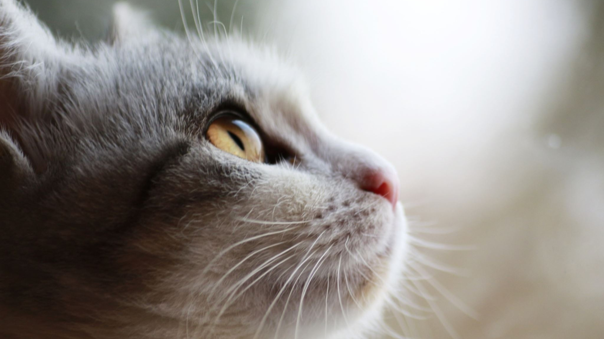
Your system is an animal
But which animal?

Slide 2

Is it a human?

Slide 3
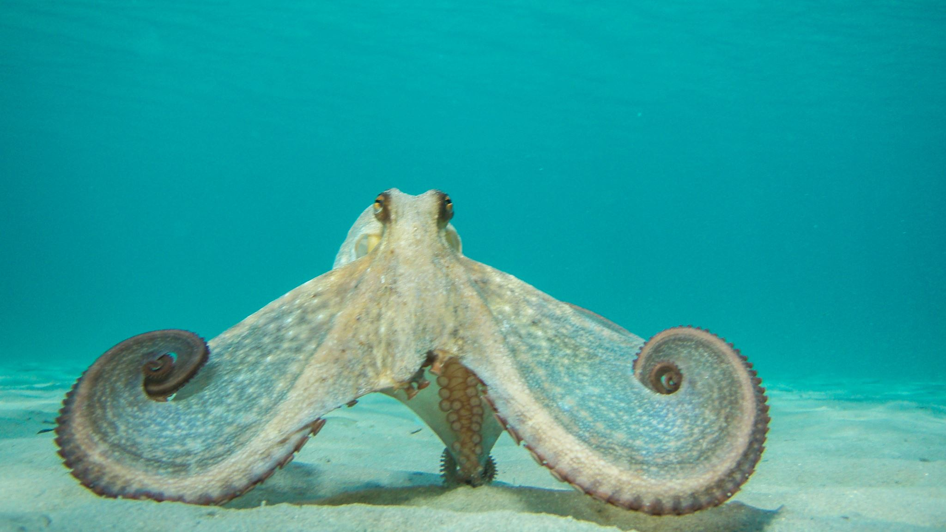
Is it an Octopus?

Slide 4
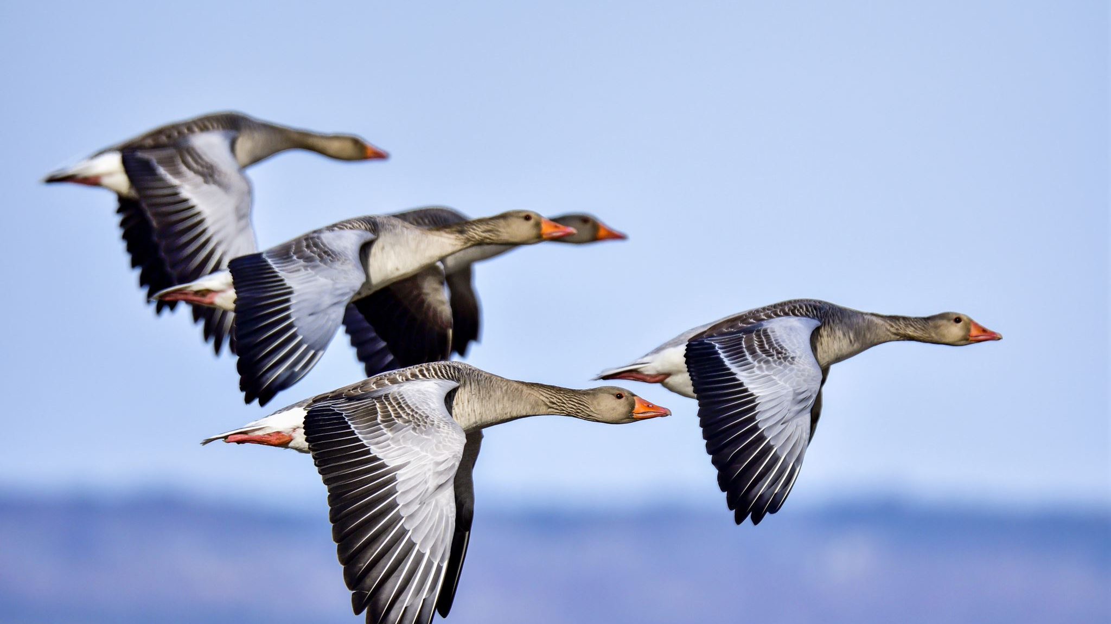
Is it a flock of birds?

